Slide 1
Common Mechanisms

Slide 2
Getting started
UML provides the basic notations to visualize, specify, construct and document the artifacts of a software intensive system.
Sometimes, the user might need to represent information through notations which are not available in UML.
In such circumstances, we can use the extensibility mechanisms like stereotypes, tagged values and constraints which are a part of common mechanisms in UML.

Slide 3
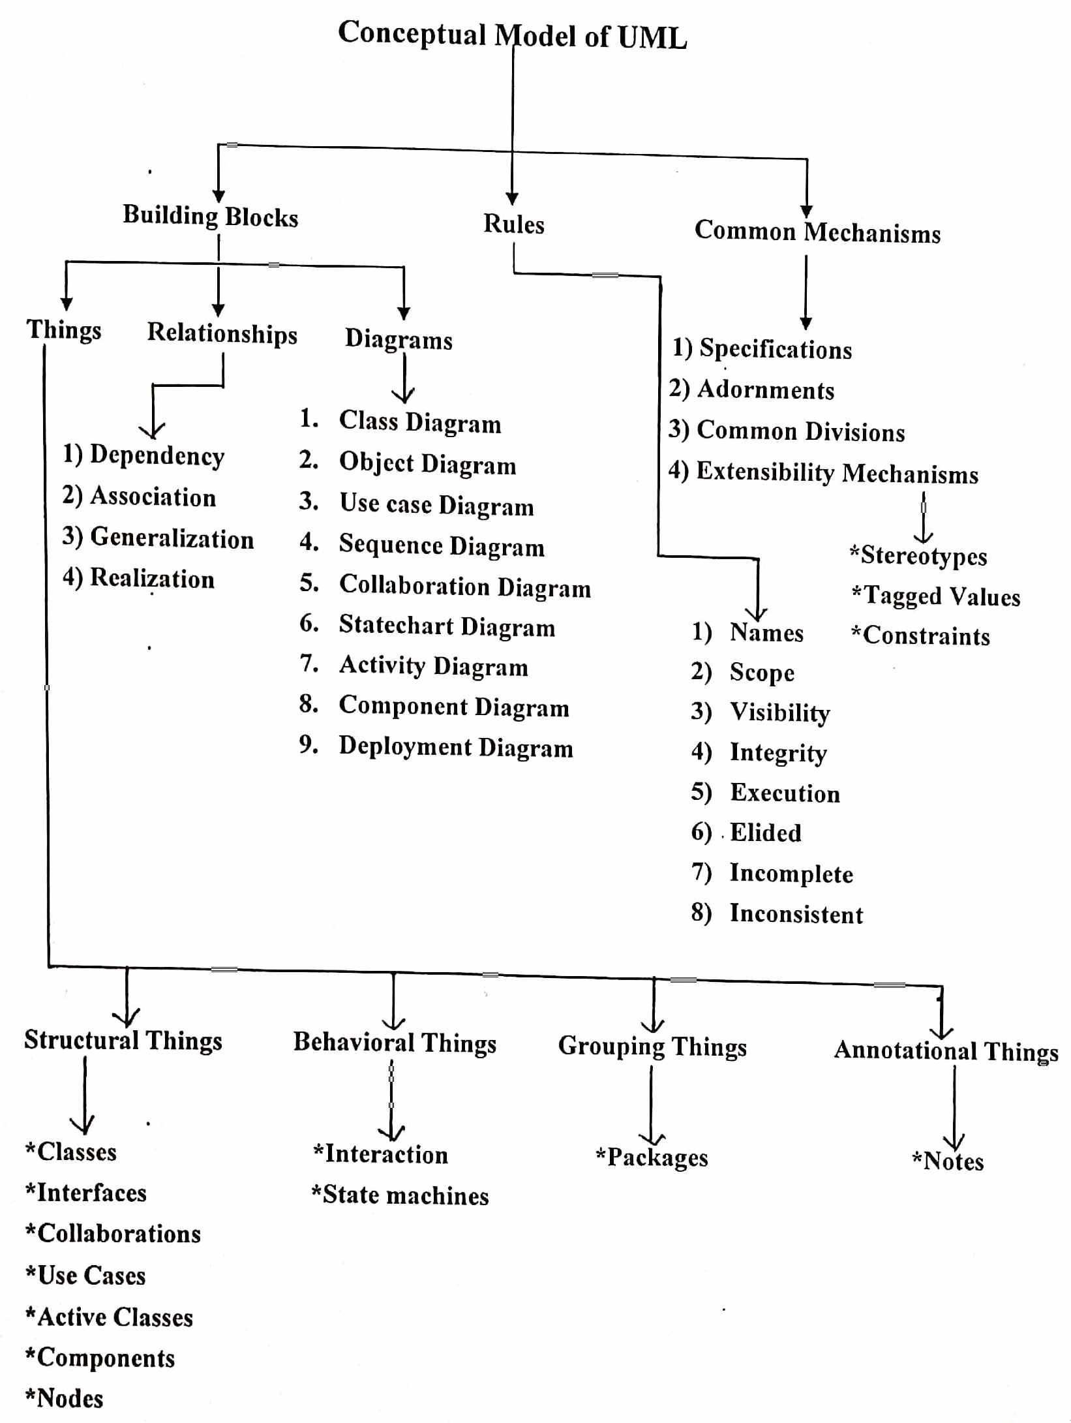

Slide 4
Notes
A note is a graphical symbol for rendering constraints or comments attached to an element or a collection of elements.
Graphically, a note is rendered as a rectangle with a dog-eared corner, together with a textual or graphical comment.

Slide 5
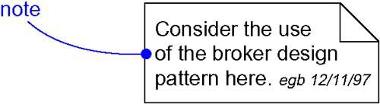
Notes

Slide 6
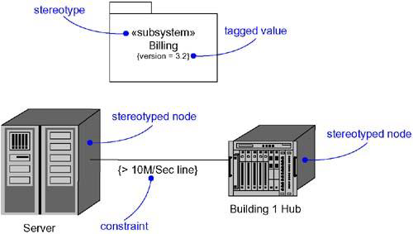
Stereotypes, Tagged Values, and Constraints

Slide 7
Other Adornments
Adornments are textual or graphical items that are added to an element's basic notation and are used to visualize details from the element's specification.
Most adornments are rendered by placing text near the element of interest or by adding a graphic symbol to the basic notation.

Slide 8
Other Adornments
Sometimes you'll want to adorn an element with more detail than can be accommodated by simple text or graphics.
In the case of such things as classes, components, and nodes, you can add an extra compartment below the usual compartments to provide this information.

Slide 9
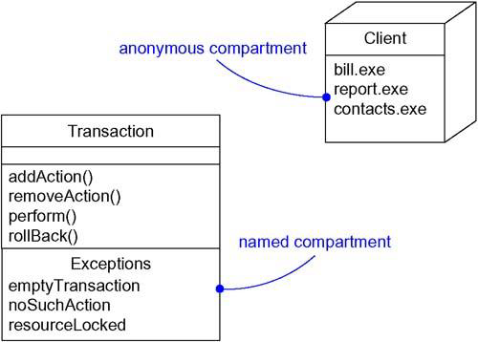
Other Adornments

Slide 10
Stereotypes
A stereotype is an extension of the vocabulary of the UML, allowing you to create new kinds of building blocks similar to existing ones but specific to your problem.
Graphically, a stereotype is rendered as a name enclosed by guillemets (<<..>>) and placed above the name of another element.

Slide 11
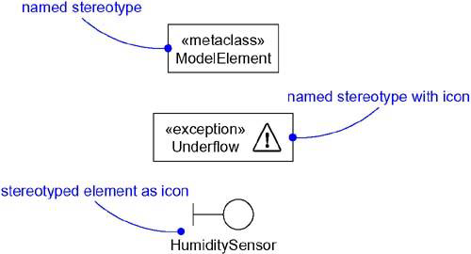
Stereotypes

Slide 12
Tagged Values
A tagged value is an extension of the properties of a UML element, allowing you to create new information in that element's specification.
Graphically, a tagged value is rendered as a string enclosed by brackets and placed below the name of another element.

Slide 13
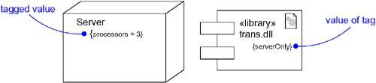
Tagged Values

Slide 14
Constraints
A constraint is an extension of the semantics of a UML element, allowing you to add new rules or to modify existing ones.
Graphically, a constraint is rendered as a string enclosed by brackets and placed near the associated element or connected to that element or elements by dependency relationships.
You can also render a constraint in a note.

Slide 15
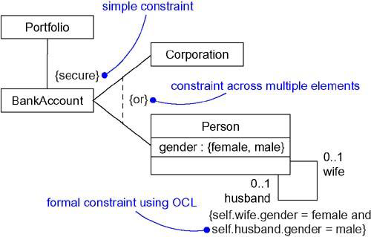
Constraints

Slide 16
Standard Elements
The UML defines a number of standard stereotypes for classifiers, components, relationships, and other modeling elements.
There is one standard stereotype, mainly of interest to tool builders:
Stereotype: Specifies that the classifier is a stereotype that may be applied to other elements.

Slide 17
Standard Elements
The UML also specifies one standard tagged value that applies to all modeling elements.
Documentation: Specifies a comment, description, or explanation of the element to which it is attached.

Slide 18
Common Modeling Techniques
There are four types of modeling techniques for common mechanisms.
Modeling Comments
Modeling New Building Blocks
Modeling New Properties
Modeling New Semantics

Slide 19
1. Modeling Comments
To model a comment:
Put your comment as text in a note and place it adjacent to the element to which it refers. You can show a more explicit relationship by connecting a note to its elements using a dependency relationship.
Remember that you can hide or make visible the elements of your model as you see fit. Rather, expose your comments in your diagrams only in so far as you need to communicate.

Slide 20
1. Modeling Comments
If your comment is lengthy or involves something richer than plain text, consider putting your comment in an external document and linking or embedding that document in a note attached to your model.
As your model evolves, keep those comments that record significant decisions that cannot be inferred from the model itself, and - unless they are of historic interest- discard the others.

Slide 21
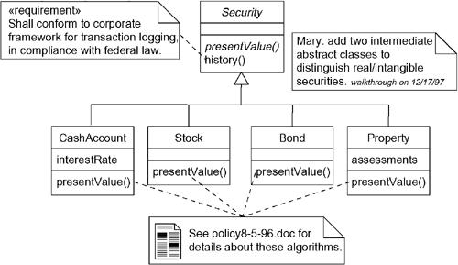
1. Modeling Comments

Slide 22
2. Modeling New Building Blocks
To model new building blocks:
Make sure there is no way to express what you want by using basic UML.
If you're convinced there's no other way to express these semantics, identify the primitive thing in the UML that's most like what you want to model and define a new stereotype for that thing.

Slide 23
2. Modeling New Building Blocks
Specify the common properties and semantics that go beyond the basic element being stereotyped by defining a set of tagged values and constraints for the stereotype.
If you want these stereotype elements to have a distinctive visual cue, define a new icon for the stereotype.

Slide 24
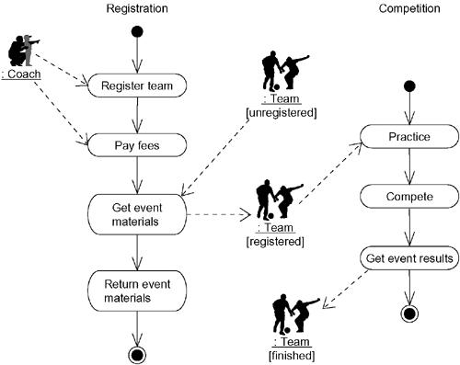
2. Modeling New Building Blocks

Slide 25
3. Modeling New Properties
To model new properties:
First, make sure there's not already a way to express what you want by using basic UML.
If you're convinced there's no other way to express these semantics, add this new property to an individual element or a stereotype.

Slide 26
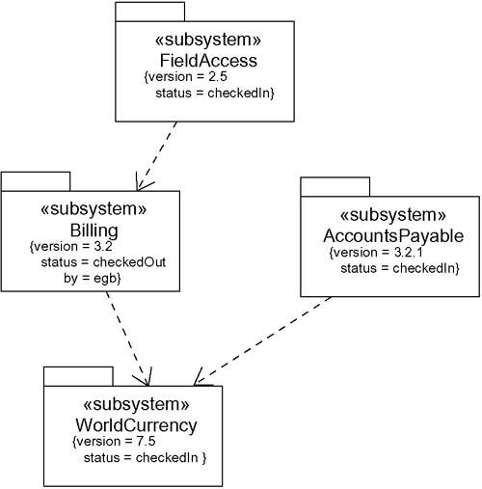
3. Modeling New Properties

Slide 27
4. Modeling New Semantics
To model new semantics,
First, make sure there's not already a way to express what you want by using basic UML.
If you're convinced there's no other way to express these semantics, write your new semantics as text in a constraint and place it adjacent to the element to which it refers. You can show a more explicit relationship by connecting a constraint to its elements using a dependency relationship.
If you need to specify your semantics more precisely and formally, write your new semantics using OCL.

Slide 28
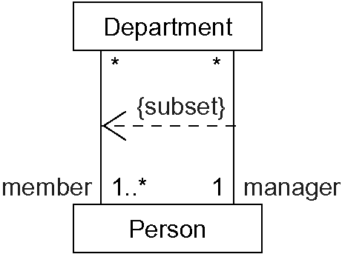
4. Modeling New Semantics

